Slide 1

Validation and Error Handling
Validating User Input and Handle Different Type of Errors
SoftUni Team
Technical Trainers
Software University
https://softuni.bg

Slide 2

Table of Contents
Validation
Why and how to validate data?
Validation and sanitization data with express-validator
Mongoose validation
Error Handling
Different types of errors

Slide 3
Have a Question?
sli.do #js-web

Slide 4

Validation

Slide 5
Validation
Why to validate?
Bigger app === more data you will need from your users at some point of time
You should prevent the user from entering something incorrect
The validation can
either succeed and allow the data to be written to the database
reject the input and return some information

Slide 6
Validation
How to validate?
Client-Side
Before any request is sent, we can use HTML or JS to approve the UX
It's optional because the user can see, change and disable the code in the browser
This is not a protection that secures you against incorrect data being sent to your server

Slide 7
Validation
How to validate?
Server-side
The code can't be seen, changed or disabled, because it happens on the server, not in the browser.
Server is the place where you should add validation and filter out the invalid data
After that, you will be sure you only work with valid data and store the correct information into the database

Slide 8
Validation
How to validate?
Database
For most database engines there is a build in validation which you can turn on
It's not required, because there should be no scenario where your database work with invalid data
Make sure you have proper server-side validation and your database works with correct data

Slide 9
Validation
validator.js - Is a library of string validators and sanitizers
Installation and Usage
Server-side usage
Client-side usage
npm install validator
const validator = require('validator');
const body = req.body;
validator.isEmail(body.email); // true or false
<script type="text/javascript" src="validator.min.js"></script>
<script type="text/javascript">
validator.isEmail($('#email').val()); // true or false
</script>

Slide 10
Validation
express-validator - Is a set of express.js middlewares that wraps validator.js validator and sanitizer functions
Installation and usage
npm install express-validator
const { check, validationResult } = require('express-validator');
check('email').isEmail()
check('password').isLength({ min: 5 });
const errors = validationResult(req);
if(!errors.isEmpty()) // Return 422 status and export errors
// Create user...

Slide 11
Validation
Sanitizers are functions which implement sanitization which is
Making sure that the data is in the right format
Removing any illegal character from the data
normalizeEmail: canonicalizes an email address
trim: trim characters from both sides of the input
blacklist - remove characters that appear in the blacklist
and more...

Slide 12
Validation
Sanitizing input is also something that makes sense to be done
You can do it in one step with validating
const { body } = require('express-validator');
body('email')
.isEmail() // check if the string is an email (validation)
.normalizeEmail(), // canonicalizes an email address (sanitization)
body('password')
.isLength({ min: 5 })
.isAlphanumeric()
.trim() // trim characters (whitespace by default) - sanitization

Slide 13
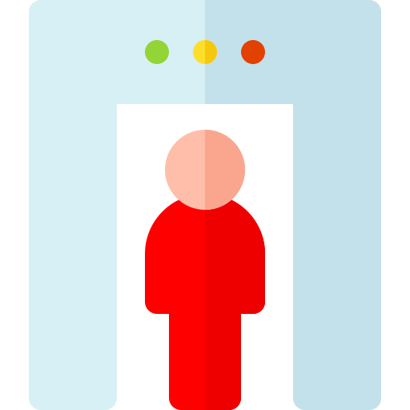

Validation
Тhе sanitization mutates the request
This means that if req.body.email was sent
with the value "PeteR@ood.bg "
after the sanitization its value will be "peter@ood.bg"

Slide 14
Validation
Express-validators allows you to create custom validations and that send custom messages
Custom validator
const { body } = require('express-validator');
app.post('/user', body.('email').custom(value => {
return User.findUserByEmail(value)
.then(user => {
if(user){
return Promise.reject('E-mail already in use');
}
});
};

Slide 15
Validation
Custom Sanitizer
Can be implemented by using the method .customSanitizer()
const { sanitizeParam } = require('express-validator');
app.post('/object/:id', sanitizeParam('id').customSanitizer(value => {
return ObjectId(value);
}), (req, res) => {
// Handle the request...
});

Slide 16
Mongoose Validation
Validation is defined in the SchemaType
Validation is middleware
Mongoose registers validation as a pre('save') hook
It's asynchronously recursive
can be customizable
unique option for schemas is not validator
It's a convenient helper for building MongoDB unique indexes

Slide 17
Mongoose Save/Validate Hooks
The save() function triggers validate() hook
all pre('validate') and
post('validate') hooks
get called before any
pre('save') hook
schema.pre('validate', function() {
console.log('this gets printed first');
});
schema.post('validate', function() {
console.log('this gets printed second');
});
schema.pre('save', function() {
console.log('this gets printed third');
});
schema.post('save', function() {
console.log('this gets printed fourth');
});

Slide 18
Mongoose Built-in Validators
All SchemaTypes have built-in required validator
Numbers have min and max validators
Strings have enum, match, minelngth and maxlength
const userSchema = new Schema({
username: {
type: String,
required: true,
unique: true,
minlength: 4,
maxlength: 20,
},
});

Slide 19
Mongoose Custom Validators
return /\d{3}-\d{3}-\d{4}/.test(v);
return /\d{3}-\d{3}-\d{4}/.test(v);
If the build-in validators aren't enough, you can define custom validators to suit your needs
const userSchema = new Schema({
phone: {
type: String,
validate: {
validator: function(v) {
return /\d{3}-\d{3}-\d{4}/.test(v);
},
message: props => `${props.value} is not a valid phone number!`
},
required: [true, 'User phone number required']
}
});

Slide 20
Mongoose Validation Errors
Errors returned after failed validation contain an error object whose values are ValidatorError object
has kind, path, value and message properties
toy.save((err) => {
assert.equal(err.errors.color.message, 'Color');
assert.equal(err.errors.color.kind, 'Invalid color');
assert.eqial(err.errors.color.path, 'color');
assert.equal(err.errors.color.value, 'Green');
...
});

Slide 21
Validation
No matter which approach you choose, in the end some of the validations can fail
You should always return a helpful error message to the user
Never reload the page but always keep the user data inserted because that is a bad user experience
More info
https://express-validator.github.io/docs/
https://mongoosejs.com/docs/validation.html

Slide 22

Validation Demo

Slide 23

Error Handing

Slide 24
Error Handling
Errors in your code should be handled properly
These errors can be different types
Technical/Network Errors
"Usual"/"Expected" Errors
Bugs/Logical Errors

Slide 25
Error Handling
Technical/Network errors
MongoDB server might be down
"Usual"/"Expected" Errors
File can't be read or some database operation fails
Bugs/Logical
User object used when it doesn't exist
This errors are our fault
They should be fixed during development

Slide 26
Working with Errors
An error is a technical object in a node application. This built-in error object can be thrown
Synchronous code
try-catch
Asynchronous code
then()-catch()
In the end in both scenario, you have to choice
Directly handle the error
Use ExpressJS functionality

Slide 27
Error Handling
There is a scenarios where you can't continue, but there is no technical error
If some user try to login, but the username does not exist
You must check the values and decide what to do
Throw an error
Directly handle the "error"

Slide 28
Error Handling
Handling errors synchronously
const User = require('../models/User/);
async (req, res, next) => {
const { username, password } = req.body;
try{
const currentUser = await User.findOne({ username });
// Login...
} catch (e) {
// Handle error properly...
}
};

Slide 29
Error Handling
Handling errors asynchronously
Post.findById(postId)
.then((post) => {
// Delete post
})
.catch(error => {
if (!error.statusCode) {
error.statusCode = 500;
}
next(error); })
If status code is missing, then something went wrong with the server
The error is sent to the middleware

Slide 30

Error Handling
In all cases you can
Return an error page
Return a response with
error information
Redirect

Slide 31
Error Handling Demo

Slide 32
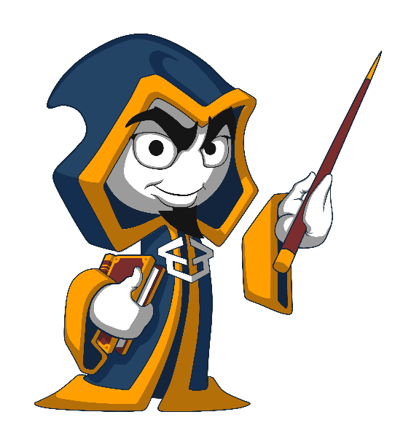
Summary
Validation
Why and how validate data?
Validating and sanitization data with express-validator
Mongoose validator
Error Handling
Different types of errors
…
…
…

Slide 33
Questions?
Notes:
33

Slide 34











SoftUni Diamond Partners

Slide 35



Educational Partners

Slide 36
Trainings @ Software University (SoftUni)
Software University – High-Quality Education, Profession and Job for Software Developers
softuni.bg
Software University Foundation
softuni.foundation
Software University @ Facebook
facebook.com/SoftwareUniversity
Software University Forums
forum.softuni.bg
Notes:
36

Slide 37

License
This course (slides, examples, demos, exercises, homework, documents, videos and other assets) is copyrighted content
Unauthorized copy, reproduction or use is illegal
© SoftUni – https://about.softuni.bg/
© Software University – https://softuni.bg
Notes:
37

